Slide 1
电池全生命周期健康管理
Comprehensive Design
Mar 15，2024
小组成员：王浩羽、李宗润、徐涵

Slide 2

Outline
Background, Significance and Objectives
Progress report
Plan

Slide 3
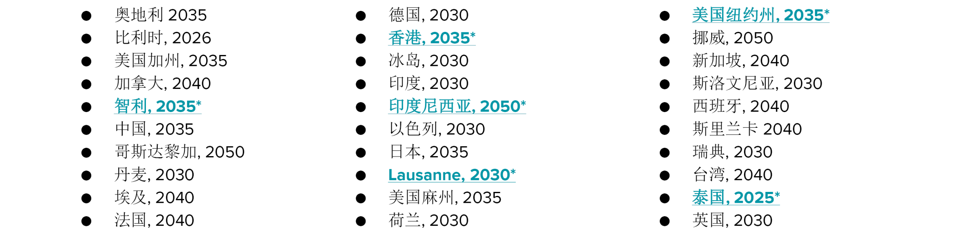
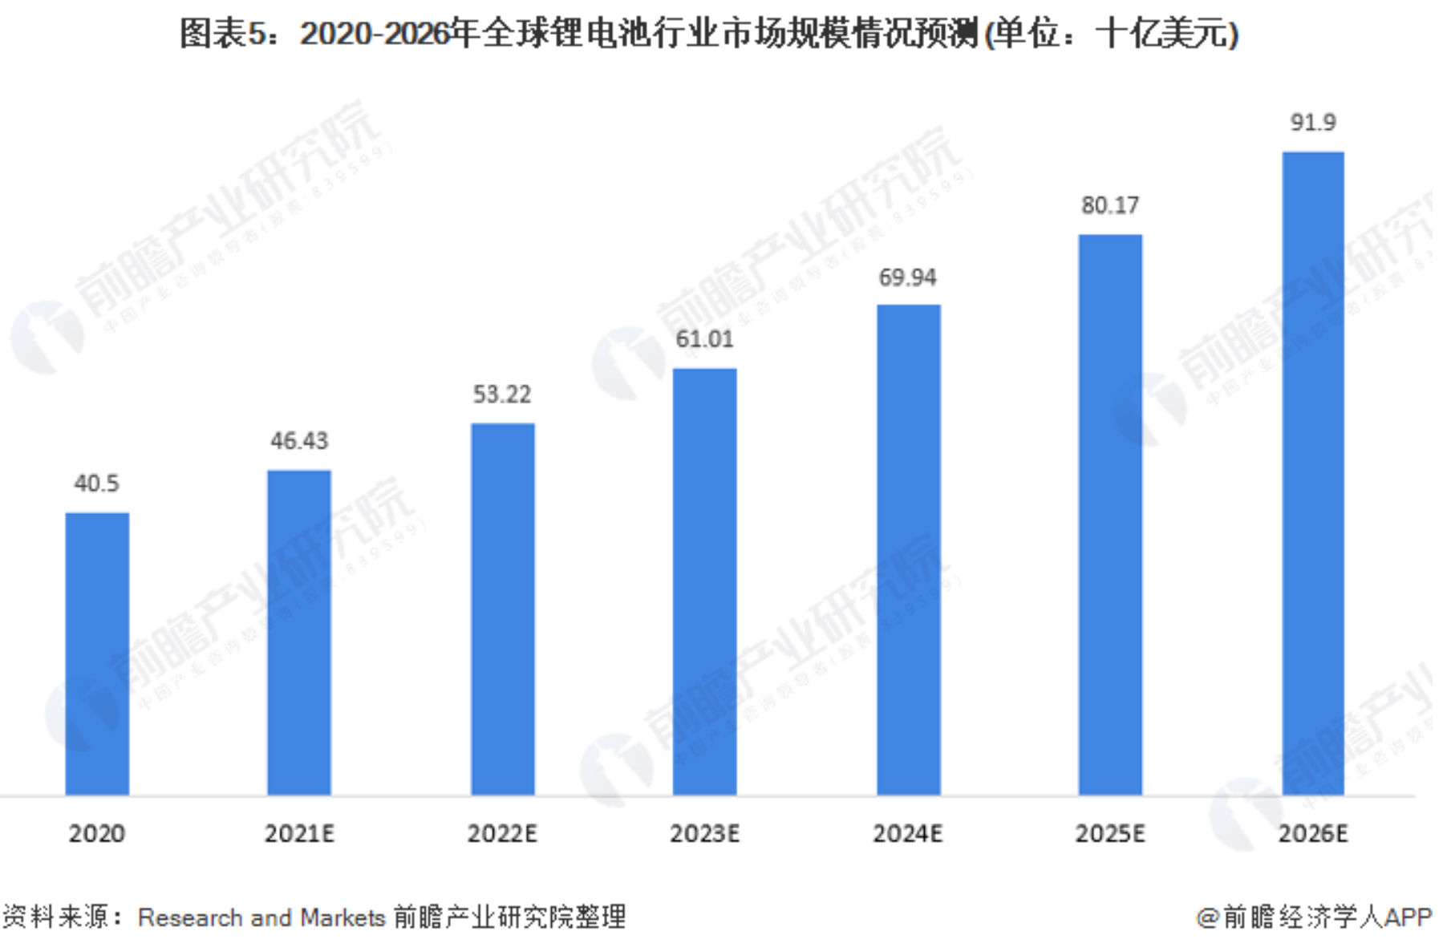
电动汽车
锂电池最大市场，目前30多个国家或地区已经宣布退出燃油车时间表
2021年全球新能源汽车销量650万辆（占9%），同期增长108%
2022上半年中国销售250万辆，同比大增121%，欧洲114万辆，北美50万
预计新能源汽车销量占比:2025年20%，2030年40%
全球电动车锂离子电池消耗量年增长率26%
《新能源汽车产业发展规划2021-2035》
Notes:
2022年6月底，全国汽车保有量4.06亿辆，其中新能源汽车1001万辆

Slide 4
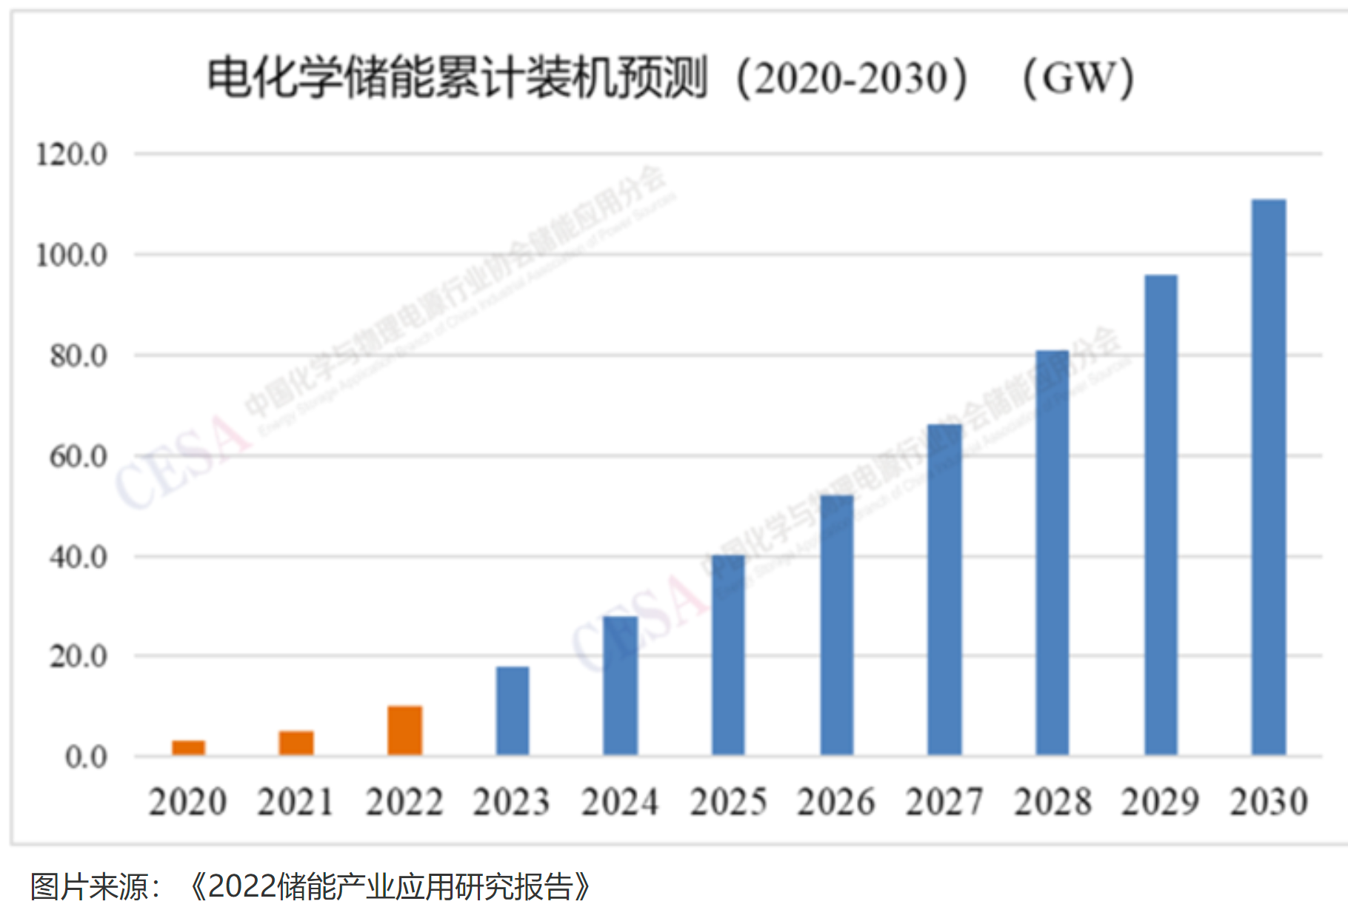
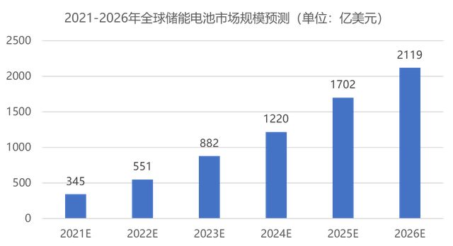
储能
电池的下一个超万亿美金市场
2021年中国发布《关于加快推动新型储能发展的指导意见》
2025年，装机规模达到30GW，2030年全面市场化发展

Slide 5
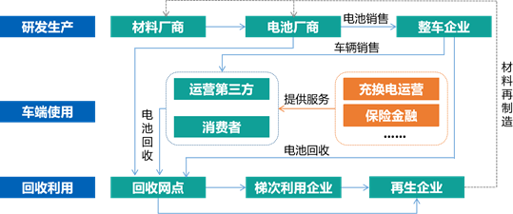
Background, Significance and Objectives
Advantage：
Improve battery performance and safety
Provides support for the secondary utilization of batteries to ensure the reliability of the secondary utilization
Notes:
背景和意义的阐述需要清晰的说明项目的why的内容！为什么我们要做这个项目，基于哪些背景需求，解决了这些需求有什么意义，这些意义才是我们科研工作的研究价值。

Slide 6
Material Science Part 李宗润
Process Report
Future Plan

Slide 7
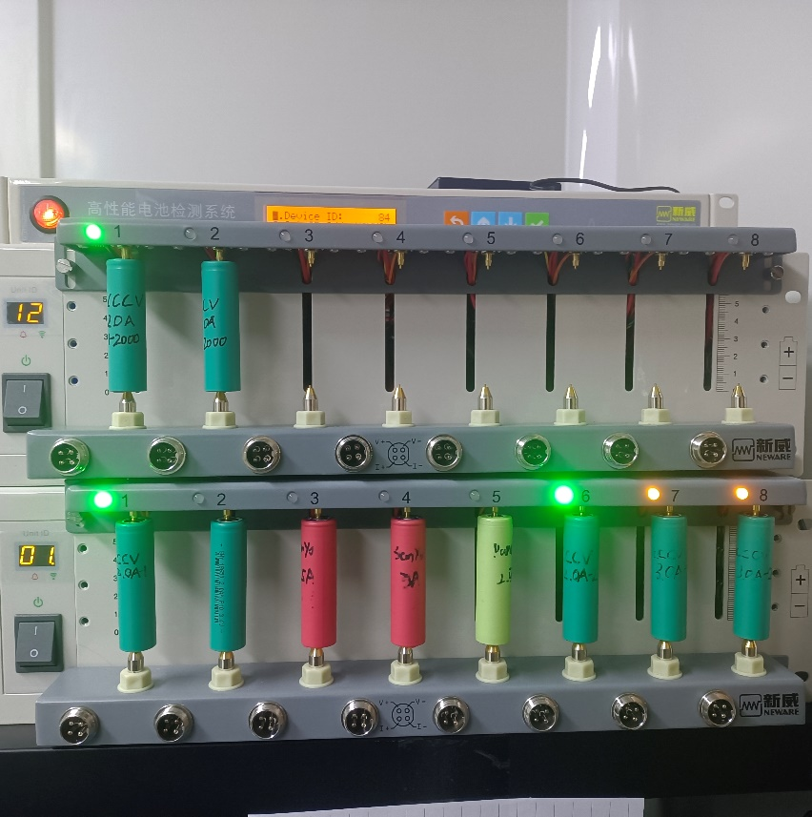
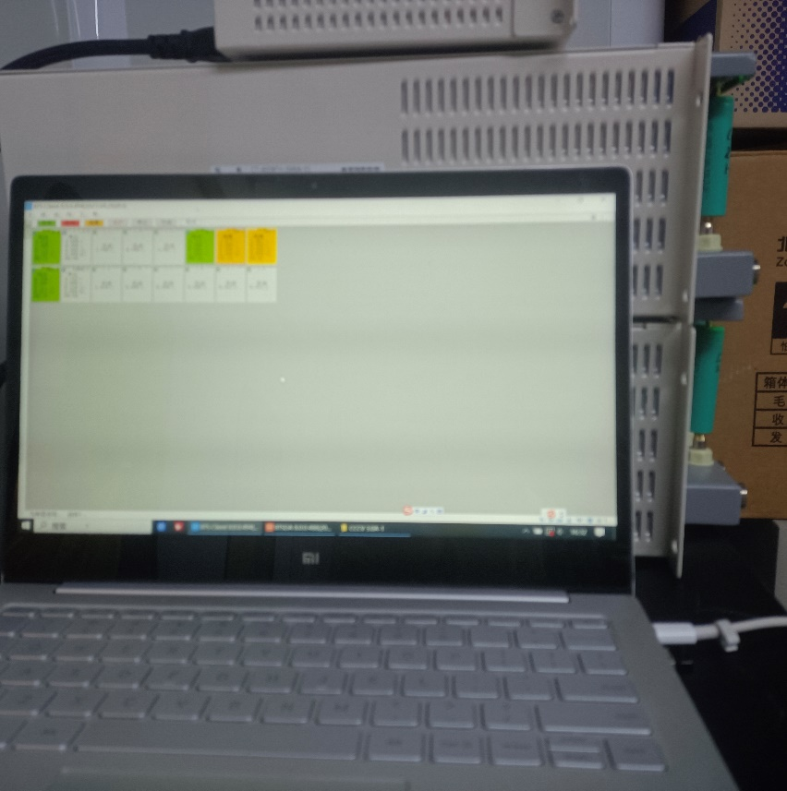
Progress report
Electrochemical Workstation
Progress：
Test platform:
Electrochemical Workstation
EIS
Battery：
SANYO&PANA (4.3V) ()
18650 (4.3V)
Button battery: LIR2032 (3.6V)
PC
Cycle test equipment

Slide 8
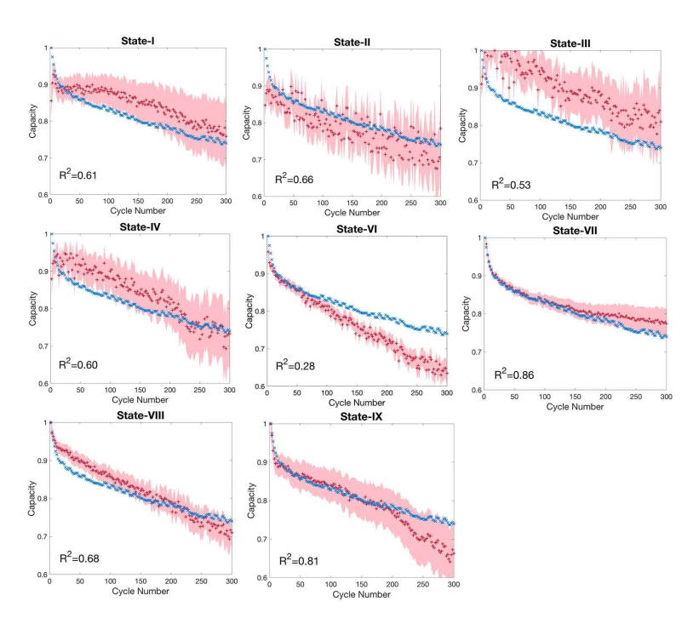
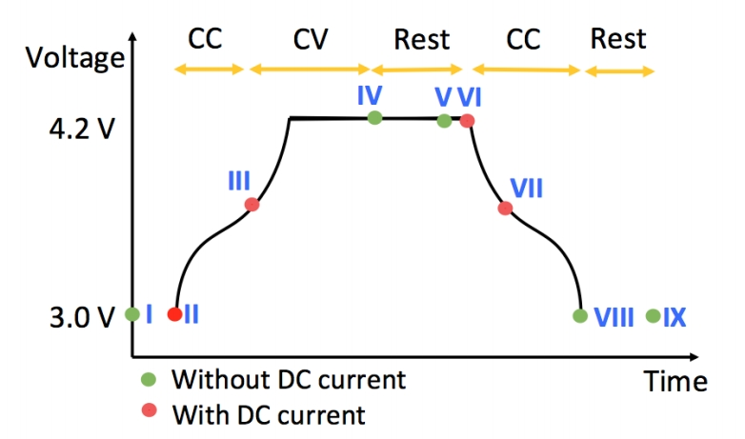
Progress report
Problem：

Slide 9
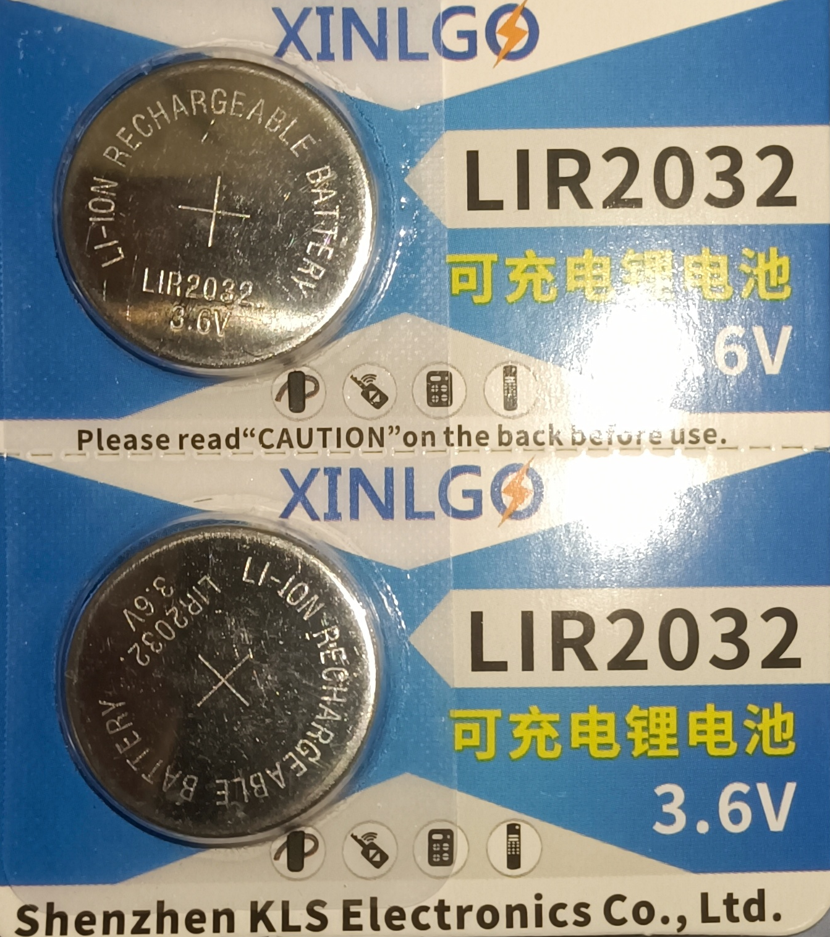
Plan
Button cell test:
Model：LIR2032
Test cycle:
CC
CV
Rest
Record
EIS
Discharge

Slide 10
Microelectronics Part 徐涵
Process Report
Future Plan

Slide 11
Progress report
目标：测得电池的完整充放电曲线
工作：搭建控制电池充放电并对电压电流采样的硬件电路
无线通信模块
电压监测模块
电池采样芯片
stm32芯片
电流监测模块
储存模块
电池充电模块
电池

Slide 12
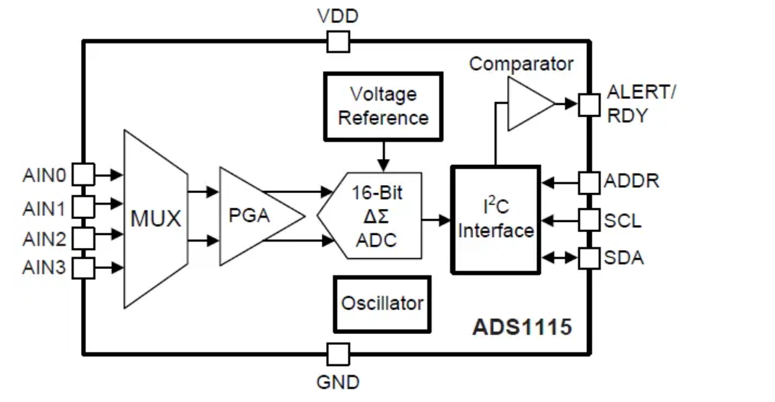
Progress report
电压监测电路
ADS1115是德州仪器推出的具有IIC接口的16位ADC转换器，超小型X2QFN或VSSOP 封装，低功耗（20uA），宽电压输入2.0V-5.5V
1.量程合适：0-6.144V
2.引脚少，方便封装：ssop10

Slide 13
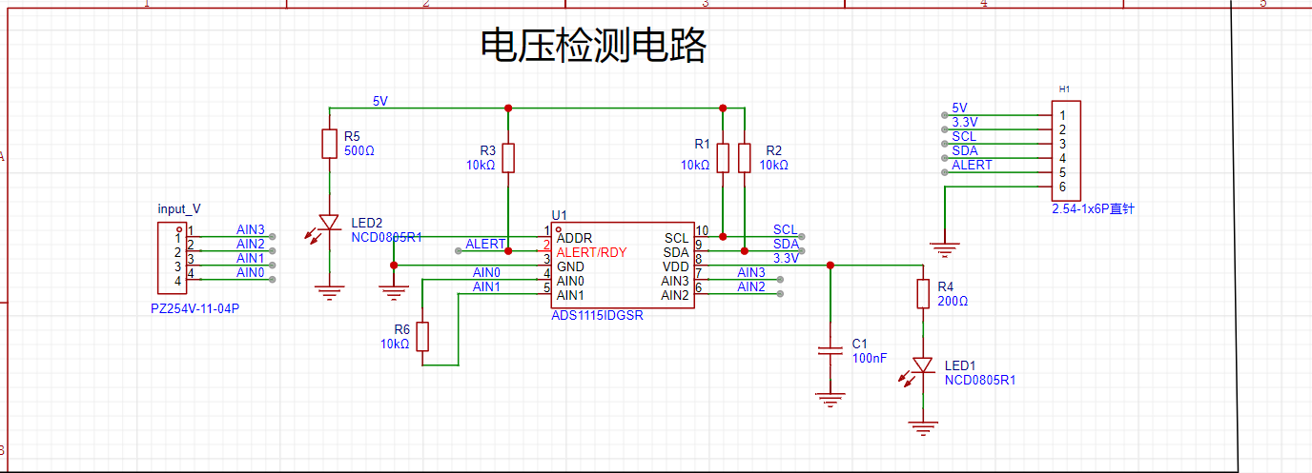
Progress report
电压监测电路

Slide 14
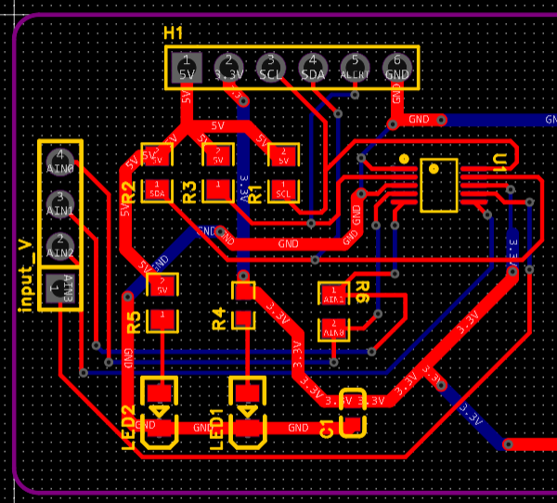
Progress report
电压监测电路

Slide 15
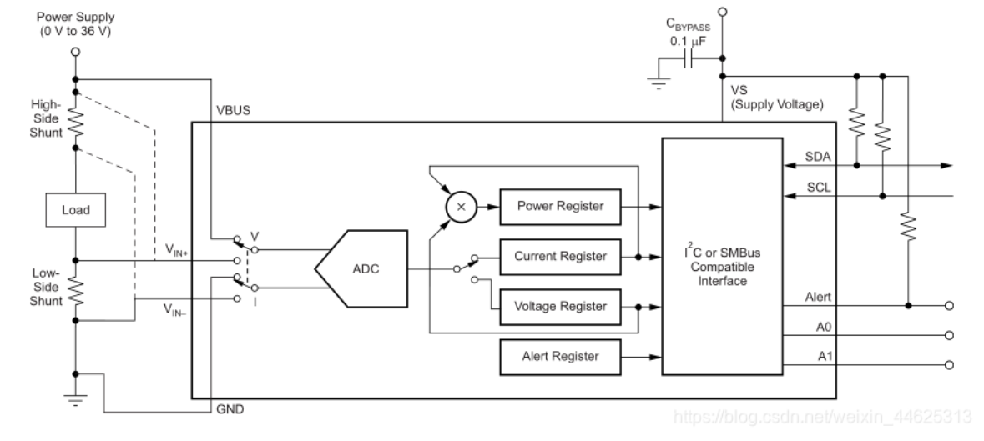
Progress report
电流监测电路
INA226 是一款分流/功率监视器，具有I2C™或 SMBUS 兼容接口。该器件监视分流压降和总线电源。可编程校准值、转换时间和取平均值功能与内部乘法器相结合，可实现电流值（单位为安培）和功率的直接读取。

Slide 16
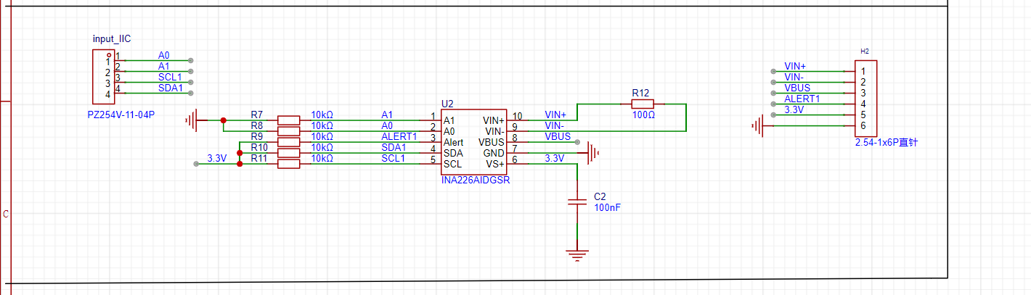
Progress report
电流监测电路

Slide 17
Progress report
电流监测电路

Slide 18
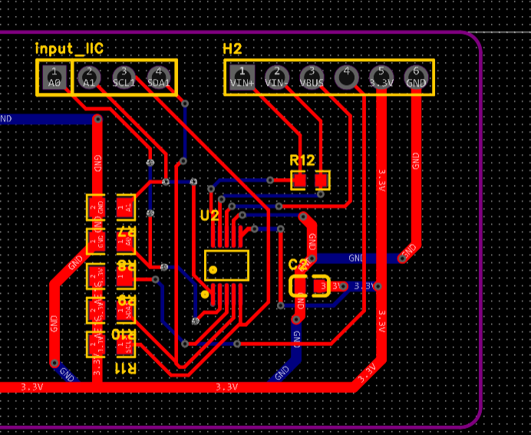
Progress report
电流监测电路

Slide 19
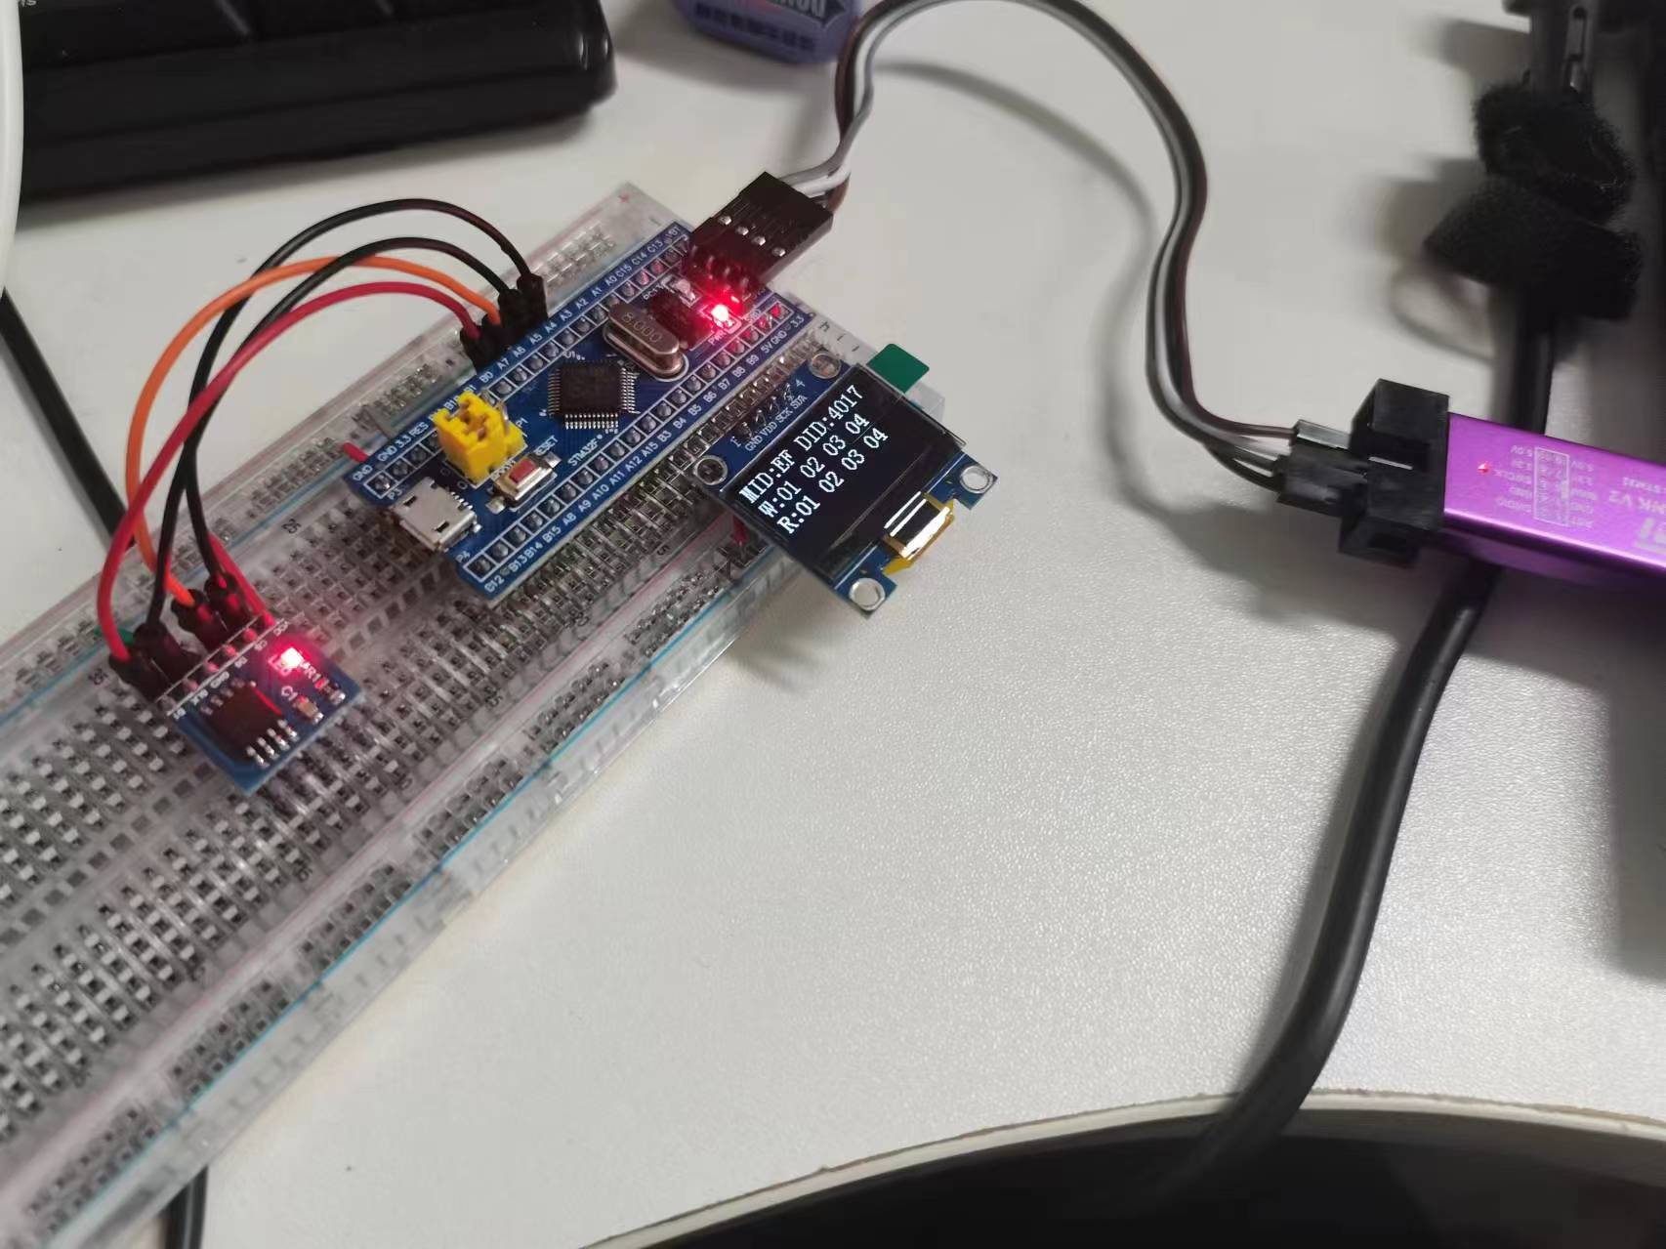
Progress report
储存模块电路
W25Q64储存芯片

Slide 20
Plan
Personal Thesis Topic | Specific Matters | Owner | Time Frame
电池健康状态监测硬件系统； | 完整电池充放电曲线获取 | 徐涵 | 3.1-3.15：电压电流监测模块搭建与测试 3.15-3.30：电池充电模块搭建与测试 4.1-4.15：电池完整充放电曲线获得与无线通信模块搭建 4.15-4.30：完整模块运行与测试

Slide 21
Computer Science Part 王浩羽
Goals and Objectives
Proposed Methods
Data Exploration
Data Processing
Experimental Results
Future Works

Slide 22
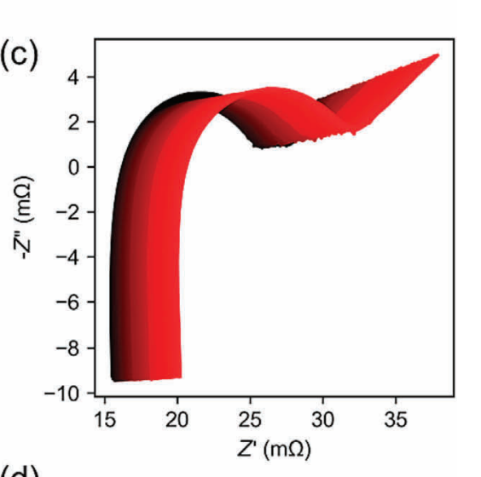
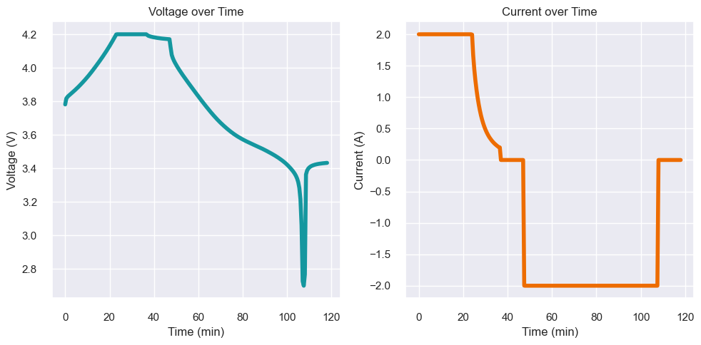
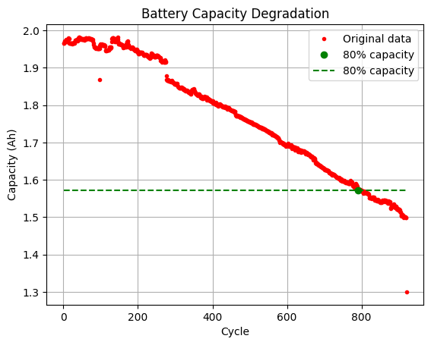
Goals and Objectives
Based on charging curves
and EIS curves
Predict battery Remaining Useful Life (RUL)
Capacity decreases to 80% of original capacity

Slide 23
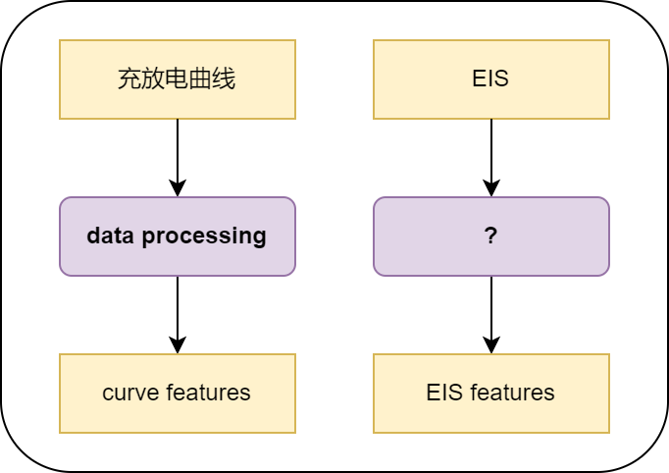
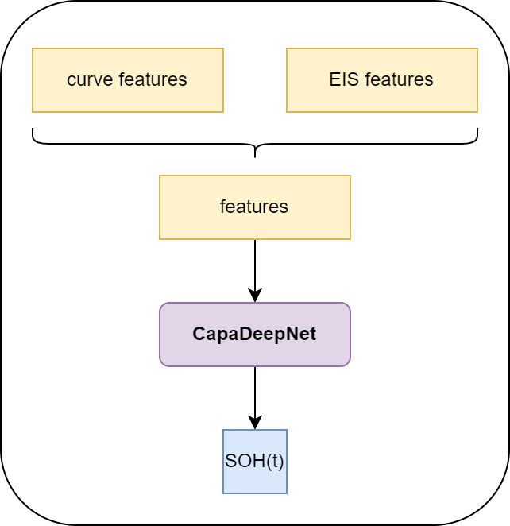
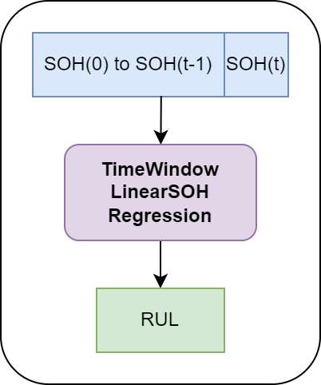
Proposed Methods
Step1
Data Processing
Step2
Predict SOH(t)
Step3
Estimate RUL

Slide 24
Data Exploration
Datasets:
6 battery already have
2 battery in future
battery | charging protocol | CC current | CV voltage | cycle
0 | CC-CV | 2.0A | 4.2V | 904
1 | CC-CV | 2.0A | 4.2V | 898
2 | CC-CV | 2.0A | 4.2V | 911
3 | CC-CV | 3.0A | 4.2V | 902
4 | CC-CV | 3.0A | 4.2V | 920
5 | CC-CV | 3.0A | 4.2V | 918

Slide 25
Data Exploration
Data in datasets:
Battery charging curves
(1 curve per cycle)
Battery EIS curves
(1 curve per 10 cycle)
Discharging capacity

Slide 26
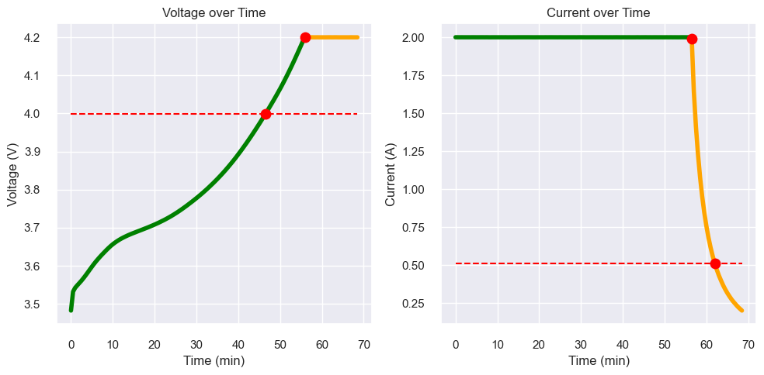
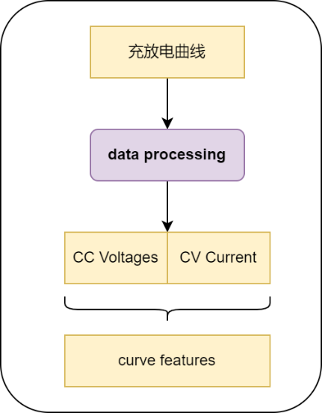
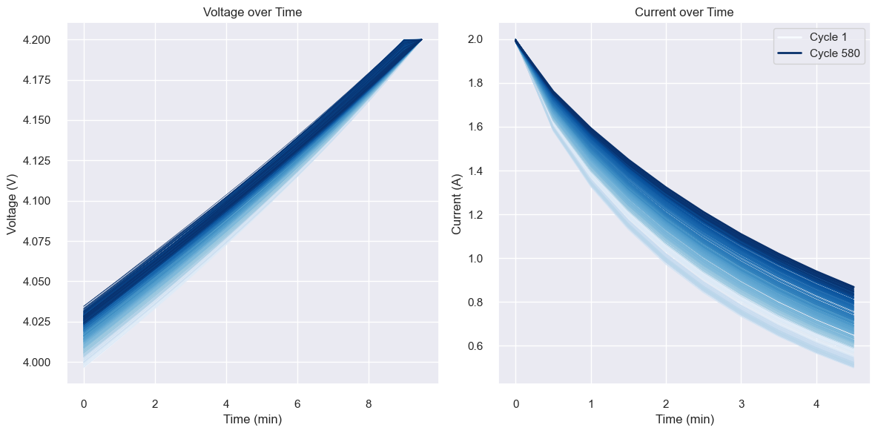
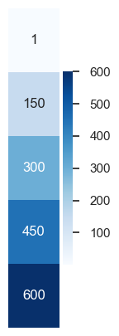
Data Processing
Step1: Data Processing
CC Voltage
CV Current
CC
Voltage
Sample points number
CC -> U: 4.0V ~ 4.2V; I=2.0A
CV -> I: 2.0A ~ 0.5A; U=4.2V
Sample points number
CC Voltage: 20
CV Current: 10
CV Current

Slide 27
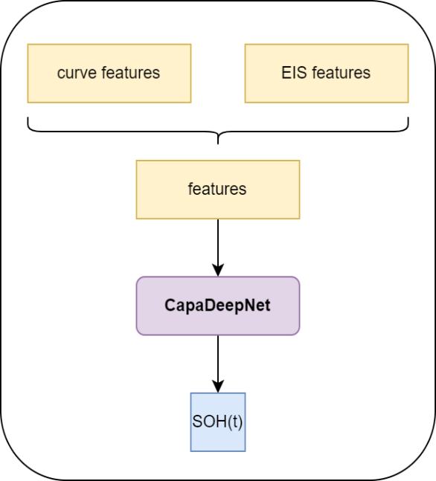
Experimental Results
Step2: CapaDeepNet
Integrative Deep Neural Net of Charging Profiles and Electrochemical Impedance Spectroscopy for Precise Battery Capacity Prediction
DeepNet Structure:
Hyper Params:
Epoch：50
Batch Size：16
 | layer | in-dim | out-dim
1 | FC | 30 | 32
2 | FC | 32 | 64
3 | FC | 64 | 72
4 | FC | 72 | 128
5 | FC | 128 | 64
6 | FC | 64 | 64
7 | FC | 64 | 32
8 | FC | 32 | 16
9 | FC | 16 | 8
10 | FC | 8 | 1

Slide 28
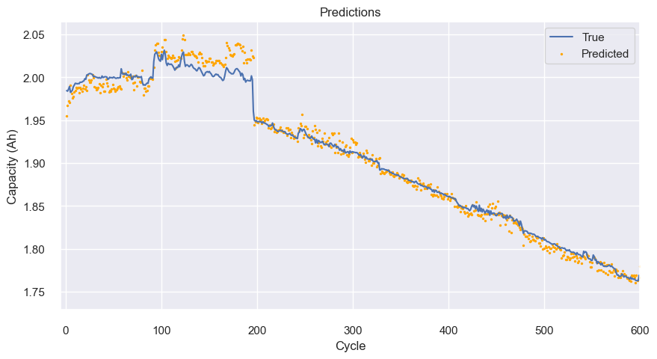
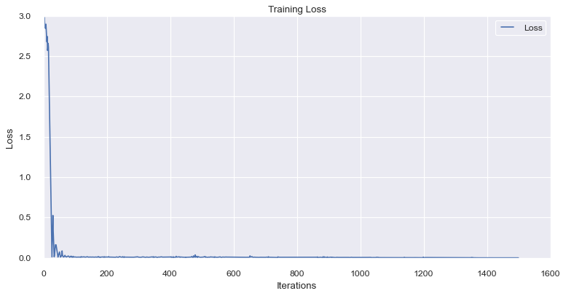
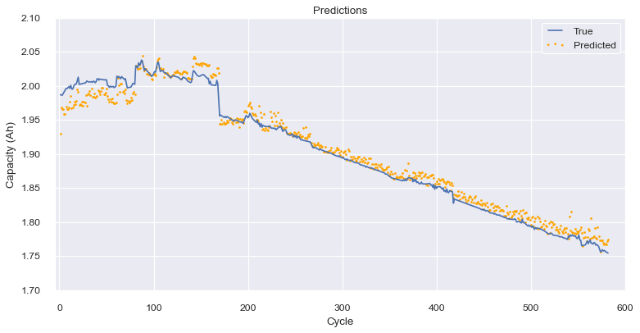
Experimental Results
Step2: CapaDeepNet Results
Battery 0: Training Data
(training and validation)
Battery 1 and 2: Evaluation

Slide 29
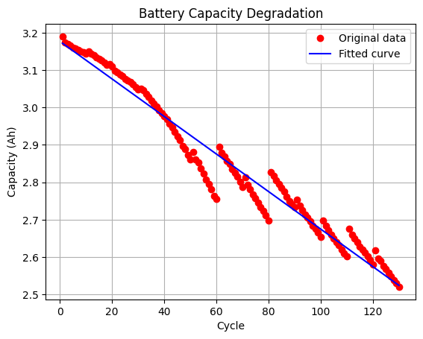
Experimental Results
Step3: TimeWindow LinearSOH Regression
Target: 80% capacity
Difficulty: Capacity Regeneration

Slide 30
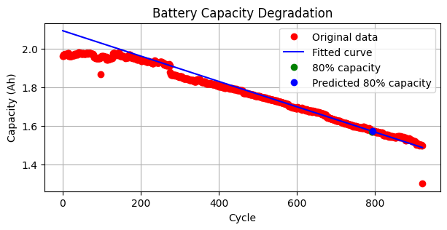
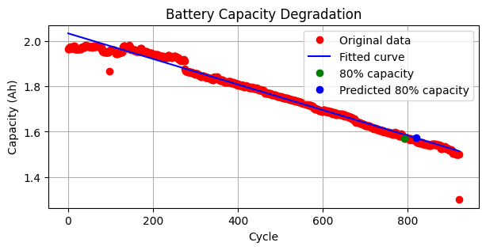
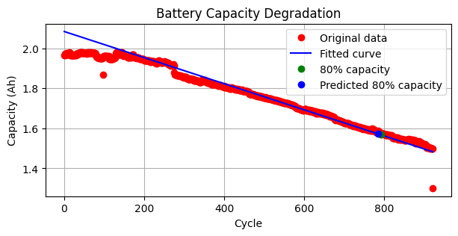
Experimental Results
Step3: TimeWindow LinearSOH Regression
Training data:
capacity of a time window
500-600
Time Window Size: 100
Step: 50
550-650
600-700

Slide 31
Future Works
To enhance the accuracy and applicability of our model
Expanding Battery Testing Scope: Testing and Analysis across Various Battery Types
Refined Feature Extraction from Electrochemical Impedance Spectroscopy (EIS) curves
Plan | Time Frame
Evaluate proposed methods on 6 datasets we already had | 3.18 – 3.31
Refine EIS features extracting | 4.1 – 4.14
Evaluate with refined methods | 4.15-4.28
Prepare materials | 4.29 -

Slide 32
Reference
1．Wang, S., Jin, S., Bai, D., Fan, Y., Shi, H., & Fernandez, C. (2021). A critical review of improved deep learning methods for the remaining useful life prediction of lithium-ion batteries. Energy Reports, 7, 5562–5574. https://doi.org/10.1016/j.egyr.2021.08.182
2．Ansari, S., Ayob, A., Hossain Lipu, M. S., Hussain, A., & Saad, M. H. M. (2022). Remaining useful life prediction for lithium-ion battery storage system: A comprehensive review of methods, key factors, issues and future outlook. Energy Reports, 8, 12153–12185. https://doi.org/10.1016/j.egyr.2022.09.043
3．Wang, S., Jin, S., Deng, D., & Fernandez, C. (2021). A Critical Review of Online Battery Remaining Useful Lifetime Prediction Methods. Frontiers in Mechanical Engineering, 7. https://doi.org/10.3389/fmech.2021.719718
4．Park, K., Choi, Y., Choi, W. J., Ryu, H.-Y., & Kim, H. (2020). LSTM-Based Battery Remaining Useful Life Prediction With Multi-Channel Charging Profiles. IEEE Access, 8, 20786–20798. https://doi.org/10.1109/access.2020.2968939
5．Xu, Q., Wu, M., Khoo, E., Chen, Z., & Li, X. (2023). A Hybrid Ensemble Deep Learning Approach for Early Prediction of Battery Remaining Useful Life. IEEE/CAA Journal of Automatica Sinica, 10(1), 177–187.
https://doi.org/10.1109/jas.2023.123024
6．Lu, J., Xiong, R., Tian, J., Wang, C., & Sun, F. (2023). Deep learning to estimate lithium-ion battery state of health without additional degradation experiments. Nature Communications, 14(1). https://doi.org/10.1038/s41467-023-38458-w
7．Zhang, Y., Tang, Q., Zhang, Y., Wang, J., Stimming, U., & Lee, A. A. (2020). Identifying degradation patterns of lithium ion batteries from impedance spectroscopy using machine learning. Nature Communications, 11(1). https://doi.org/10.1038/s41467-020-15235-7

Slide 33
Q&A

